Slide 1
www.shenzhou.com www.tmbos.com
国际中医药发展现状
Current status of overseas TCM development
Zhilin Dong
President, Pan-European Federation of TCM Societies (PEFOTS)
Madrid, 2016

Slide 2
www.shenzhou.com www.tmbos.com
中医药在海外发展迅速
Rapid development of TCM development overseas
In the last two decades, TCM has achieved rapid development overseas. North America, Southeast Asia, Pacific and European regions saw more rapid development than South Asia, Middle East, South America and Africa. TCM is still one form of alternative or complementary medicine in the West. It is estimated that there are over half a million TCM practitioners oversea (outside China).

Slide 3
www.shenzhou.com www.tmbos.com
部分国家中医从业者统计
Number of TCM practitioners/acupuncturists
Netherlands | 4000+ TCM practitioners & acupuncturists | Brazil | 10,000+/- acupuncturists
UK | 10,000+ TCM practitioners & acupuncturists | South Africa | 500+ TCM practitioners & acupuncturists
France | 10,000+ acupuncturists | Singapore | 3000+ TCM practitioners
Spain | 15,000+ TCM practitioners & acupuncturists | Malaysia | 8000+ TCM practitioners & acupuncturists
Portugal | 3000+ acupuncturists | Thailand | 1000+ TCM practitioners & acupuncturists
Germany | 50,000+ acupuncturists | Philippines | 1000+ TCM practitioners & acupuncturists
US | 40,000+ acupuncturists | Australia | 5000+ TCM practitioners & acupuncturists
Canada | 8000+ TCM practitioners & acupuncturists | New Zealand | 1500+ TCM practitioners & acupuncturists
Japan | 40,000+/- TCM practitioners, acupuncturists & massage therapists | Indonesia | 200,000+ TCM practitioners

Slide 4
www.shenzhou.com www.tmbos.com
海 外 中 医 教 学
Overseas TCM education
There are degree as well as occupational TCM education.
Occupational TCM education
About 1500 TCM schools offer occupational education in different scale, format and time durations. There is no uniform TCM education curriculum and the quality of teachers vary significantly.

Slide 5
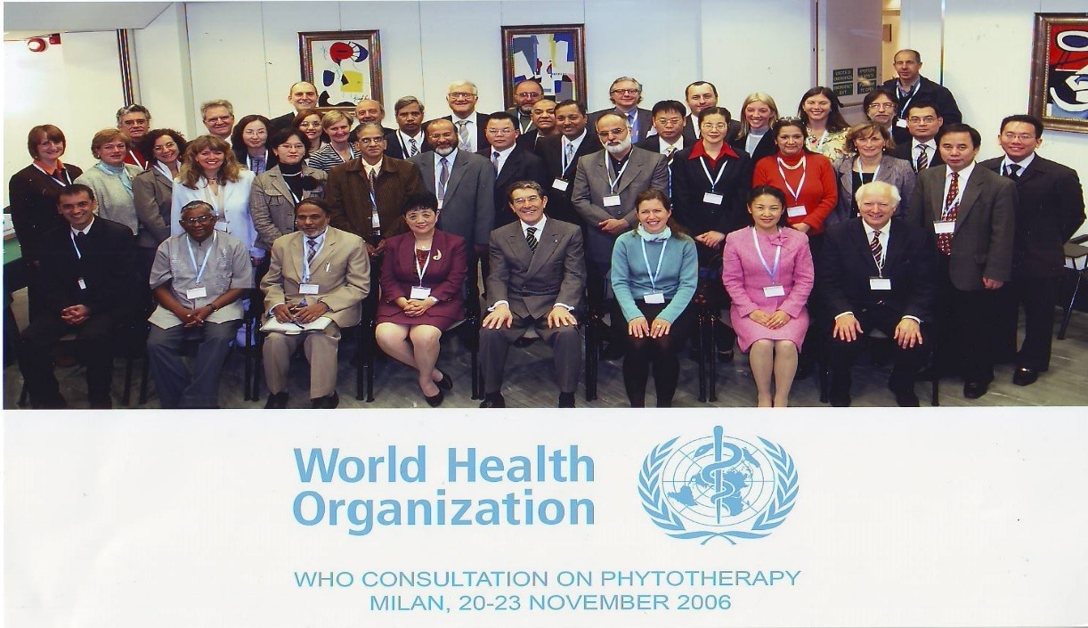
www.shenzhou.com www.tmbos.com
The World Health Organization (WHO) during its expert consensus meeting in Milan on 20-23 November 2006 recommended a minimum of 2460 hours, consisting of at least 1560 hours of theory and laboratory/clinical practice and 900 hours of supervised clinical practicum.

Slide 6
www.shenzhou.com www.tmbos.com
全日制中医针灸教育
Degree TCM/acupuncture education
Universities in the UK, Australia, New Zealand, Singapore, Malaysia, Thailand, South Korea and South Africa offer degree TCM education (4-5 years full time education).

Slide 7
www.shenzhou.com www.tmbos.com
中 医 针 灸 立 法 的 国 家
Countries with legislations on TCM/acupuncture
Countries with legislations on TCM and acupuncture | Australia, Switzerland, Hungary, South Africa, Singapore and Thailand
Countries with legislations on acupuncture | Portugal, Canada (5 provinces), US (45 states and Washington DC), Chili, Philippines and Malaysia
In legislative process | New Zealand

Slide 8
www.shenzhou.com www.tmbos.com
海外中医针灸立法表现出来的主要矛盾
Mixed feelings toward legislation
Due to culture differences, acknowledgement of TCM and acupuncture by overseas Western medical establishment differ dramatically from that of TCM physicians. Consequently, acceptance TCM and acupuncture also differ significantly.
Overseas Chinese TCM practitioners/acupuncturists have mixed feelings about legislation. On the one hand, legislation will provide legal protection for legitimate practices. On the other hand, legislation often demands local language requirements that are difficult for many overseas Chinese to meet, leading to such awkward situation where excellently qualified TCM practitioners may find themselves illegal whereas not so well qualified ones can practice legally thanks to their language advantage.

Slide 9
www.shenzhou.com www.tmbos.com
欧盟、澳大利亚、加拿大中成药立法比较
Legislations on herbal products
 | 欧盟 EU | 澳大利亚 Australia | 加拿大 Canada
立法归类 Regulatory classification | 传统药品 Traditional herbal medicinal products | 补充医学药品Complementary medicines | 天然健康产品 Natural health products
注册要求 Registration category | 传统药品注册 Traditional use registration | 登记 Listing | 登记 Licence
适应症 Indications | 非处方药适应症 OTC indications | 中医适应症 TCM/OTC indications | 中医适应症 TCM indications
生产 Manufacturing | 欧盟GMP EU GMP | 澳大利亚GMP | 生产许可 Site licence
主要销售渠道 Main distribution channel | 西药房 Pharmacy | 中医诊所 TCM practices | 中医诊所 TCM practices

Slide 10
www.shenzhou.com www.tmbos.com
欧盟传统药品注册统计
EU traditional herbal medicinal products registrations
By 2015, 1577 products have been registered as traditional herbal medicinal products in the EU.

Slide 11
www.shenzhou.com www.tmbos.com
传统药市场在全球的占有率
Global traditional medicines market
The global traditional medicines market is estimated at US$ 173 billion, including US$ 80 billion in China, US$ 42 billion in the EU, US$ 6 billion in the US, and US$ 45 billion in South East Asia, Pacific, Africa, Middle East, Russia and Canada combined. China accounts for 46% of the global traditional medicines market.

Slide 12
www.shenzhou.com www.tmbos.com
国外中医药研究现状
Status of overseas TCM research
Due to lack of efficacy and serious adverse effects of many conventional drugs, pharmaceutical companies turn to traditional medicine for safe and effective medicines. Governments and private investments also invest heavily on research in traditional medicine. Chinese government and European Commission encourage bilateral cooperation on TCM research. The EU 7th framework program granted several research projects on the effects of Chinese herbal medicine on drug resistant bacteria and diabetes. Pharmaceutical and nutritional companies also invest in researches on Chinese herbal medicine, hoping to find effective medicines and functional foods for difficult medical conditions. This may result in a new TCM biotech industry in Europe.

Slide 13
www.shenzhou.com www.tmbos.com
Thank you !
谢 谢 ！

